Slide 1
Supporting families and students in crisis through resiliency
Emma Thompson, LMFT tanager place school based supervisor

Slide 2
what we know about the brain and trauma
Any experience that leads a person feeling hopeless, helpless, fearing for their life/survival/safety.
This experience can be real or perceived
Occurs on a sensory level.
No score card when it comes to trauma

Slide 3
what we know about the brain and trauma
Body holds memory
Stored through sensory experiences – means that it’s not something that we can make sense of or talk about always
Every one handles this differently – all about how our body interpreted the experience
Top Down vs. Bottom Up

Slide 4
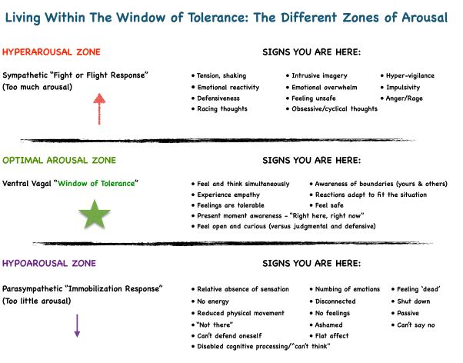
Window of tolerance

Slide 5
What families might be experiencing at home
Increased agitation, acting out, defiance in the home (these can be signs of increased anxiety)
Kids struggling with transitions
Parents feeling overwhelmed, emotional, over-worked
Increased feelings of anxiety and physical symptoms such as stomach aches
Some students may isolate, be on phones more, hide feelings of uncertainty
Trouble sleeping
These are normal feelings to experience when our lives have been altered, but we can help parents navigate how to respond and offer supports to help build family resiliency through times of crisis

Slide 6
How can you help?
Keep routines in place, set timers – these do no have to be detailed and extensive.
Be creative about new activities and exercise – ask parents what they did for fun as kids for exercise!
Managing parents own anxiety –keeping worries in check. If parents feel overwhelmed encourage them to take a break…take a shower, go for a walk, call a friend and explain your worries away from children
Limit consumption of news for all members of the family – its ok to keep kids in the loop but keep it simple
Remember to be reasonable and kind to yourself
When speaking to a parent: listen, validate, empathize!

Slide 7
How can you help?
Have a list ready of resources for parents – lots of communities are offering free support groups, short term therapy, web sites with valuable information on food resources, shelter etc.
If you run into a situation in which you are worried about a child's or parents safety call DHS, ask for a welfare check, encourage family to seek trusted supports or hospitalization if necessary.
Find ways to develop self care for yourself and to manage your own anxiety!

Slide 8
Building resiliency in the family
Attunement:
Stop talking and listen
Remain in the right brain; just be present – don’t go to lecture, logic or reasoning
Reflection, paraphrasing, validation
Even when you don’t like the behavior, acknowledge and embrace feelings.
Through attunement you give:
Insight
Help kids understand their own feelings and the responses to difficult emotions
Empathy
Give kids practice reflecting on how their actions impact others
Repair
Give gives ability to make things right and ability to problem solve.

Slide 9
Indicators of Well-being: In looking to overcome the strong feelings and struggles being faced, it is important that people look to cultivate their resilience. Resiliency is the ability to recover or overcome adversity.
Safety:
Ensure a sense of safety by staying in your home
Go out when you feel it’s necessary or access needed items through delivery or curbside
Wear “gear” or carry items such as hand sanitizer
Establish daily routines and rituals
Find our create your own retreat space
Limit conversations around COVID-19
Connection/Belonging:
Connect with others via online platforms such as Zoom, Facetime, Skype.
Write letters or cards to others.
Make a phone call to check in on others or just to say ‘hi’.
Find groups or classes online that you can participate in.
Smile and say thank you or be polite to others you may interact with or pass throughout your day.
Create family time-play games, read books together.
Play with children when possible.

Slide 10
Meaning/Purpose
Identify ways you can help others.
Identify goals or things you’d like to accomplish during this time.
Help others in ways that are safe/you feel comfortable with (donate and/or deliver items, pick up items for others when you go shopping).
Take care of yourself, go outside, move around, shower, get dressed.
Create time for journaling, reading, connecting with nature, mindfulness and finding meaning during this time.
Efficacy
Identify things that are within your control.
Find ways to share your skills with others.
Focus on small ‘chunks’ of this time and what things you can do within a day or a week.
Start a project and finish it.
Learn a new skill

Slide 11
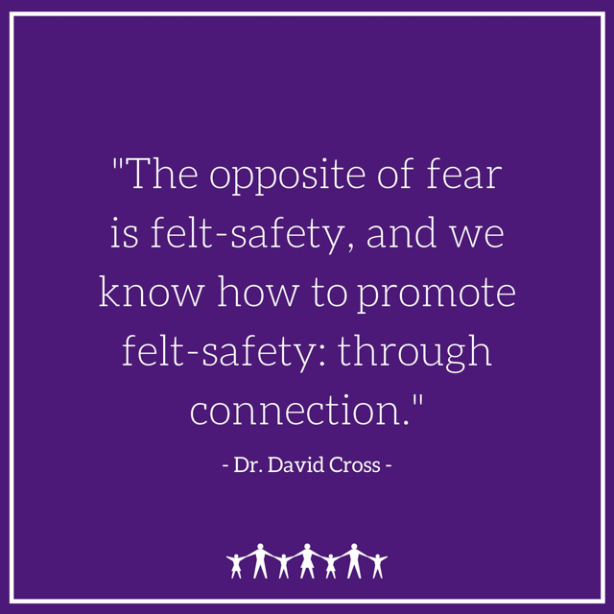
Building resiliency in the family
Encourage families to focus on REPAIR – it is inevitable that families will make mistakes during this time but what matters what you do to after to repair. Go back and apologize, explain and reconnect.

Slide 12
References
Karyn Purvis Institute of Child Development
Child Mind Institute
Flyers for support groups at Tanager Place
PowerPoint and attachments will be sent via email after presentation

