Slide 1
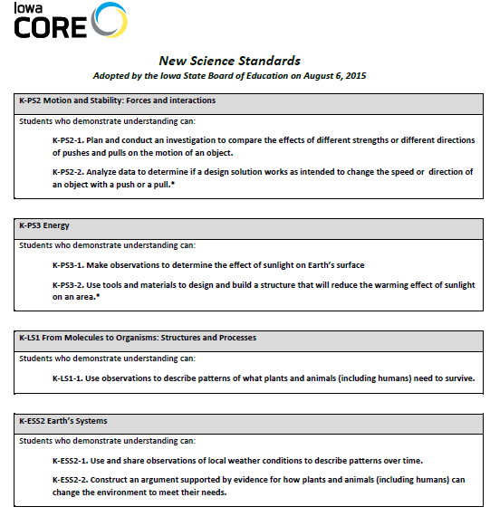
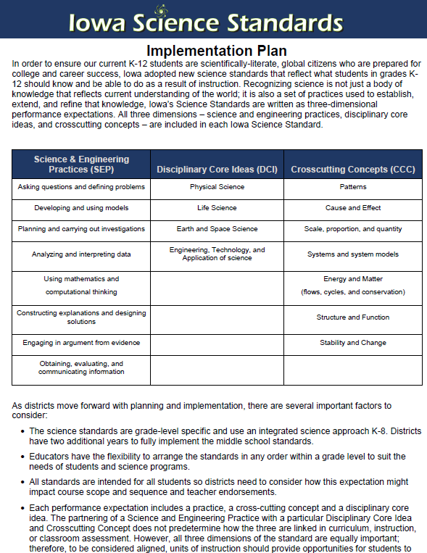
Iowa Core SCIENCE
August 2015
January 2016

Slide 2
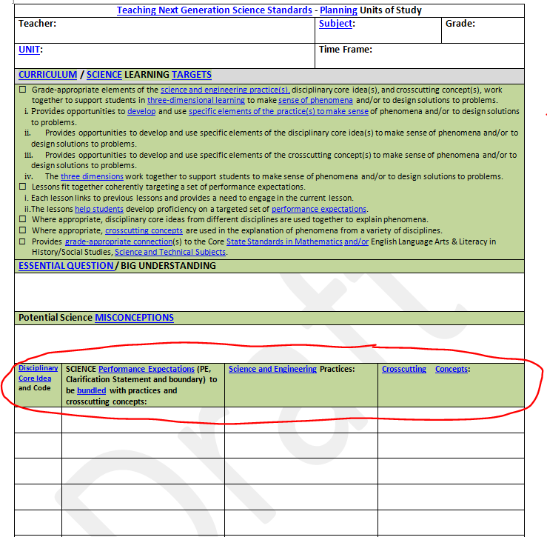

Slide 3
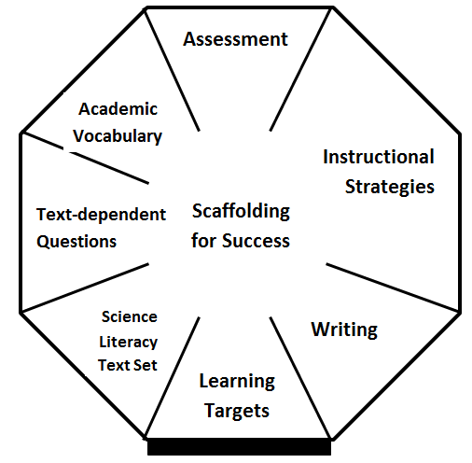
Science with Science Literacy

Slide 4
Synergy of 18 States+
SCIENCE
Standards/Appendices
Evidence Statements
EQuIP
PEEC Alignment (Primary Evaluation of Essential Criteria) DRAFT

Slide 5
6 Conceptual Shifts (Appendix A)
Interconnected of science like in the real world
Performance expectations (PE’s)of what is to be assessed (included foundation box)
K-12 coherence of disciplinary core ideas
Deeper understanding of content and application
K-12 STEM integration
Each PE Correlated to ELA/Literacy and Math
https://www.youtube.com/watch?v=N2lnsYb-pb4

Slide 6
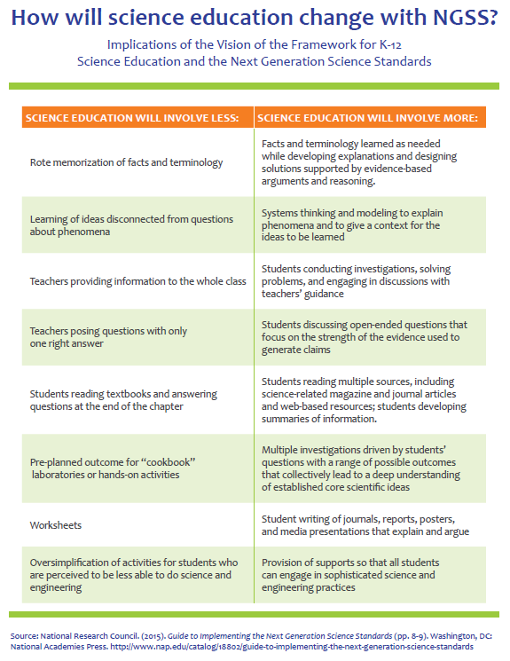
MORE
Evidence-based arguments and reasoning
Modeling
Investigations
Reading science
Discussing and writing science to make thinking visible
Scaffolding for Success

Slide 7
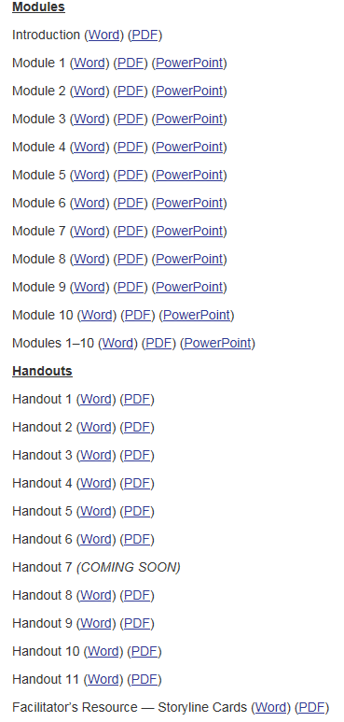
EQuIP Professional Learning Materials
http://www.nextgenscience.org/resources/equip-professional-learning-facilitator%E2%80%99s-guide

Slide 8
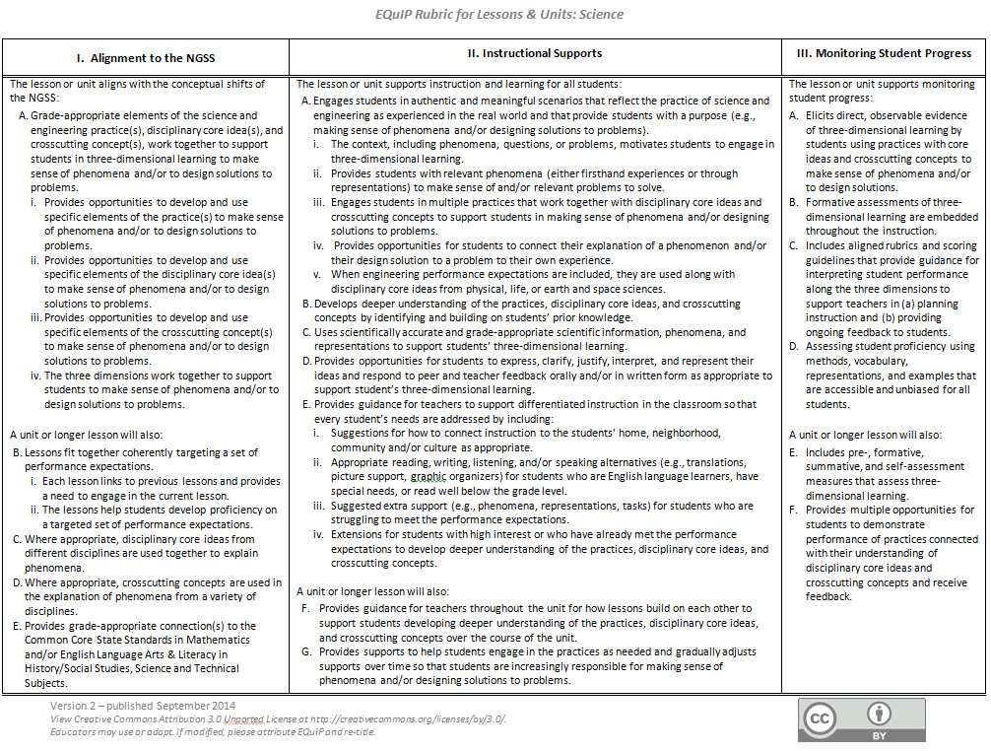

Slide 9
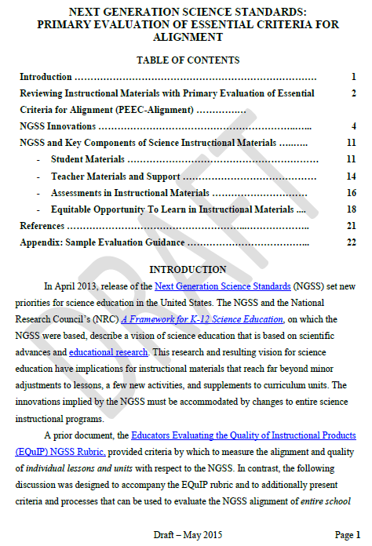

Slide 10
Curriculum caution
You won’t find much right now
It will take time
Select with care

Slide 11
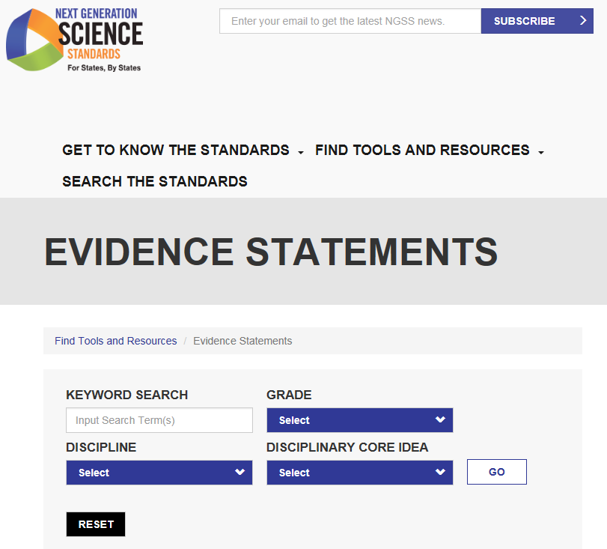
http://www.nextgenscience.org/evidence-statements

Slide 12
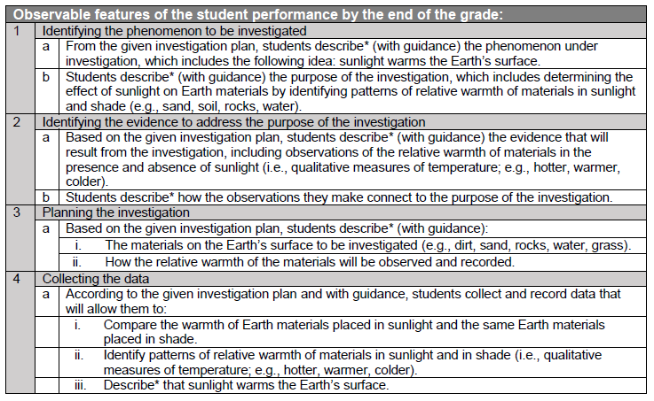

Slide 15
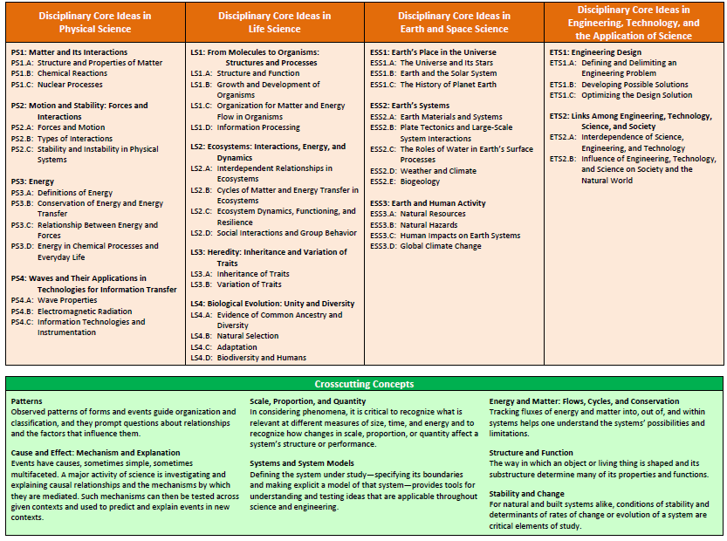

Slide 17
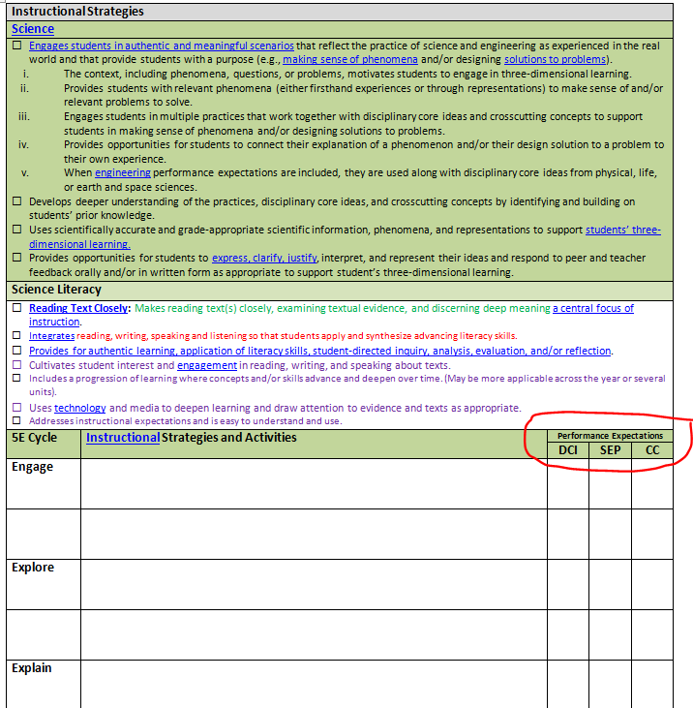

Slide 18
